Slide 1

Sage 300 Web SDK 2024.0 Overview
John Thomas (JT)
Principal Software Architect
September 2023

Slide 2
Web SDK
SDK
Wizards
Docs
Resources
Samples
Source
Goal
“The goal of the Web SDK is to get developers up and running quickly and easily.”

Slide 3

Corrected Issues

Slide 4
Corrected Issues
N/A
N/A
FYI Added controls in the footer do not respect the Before or After setting properly as Before adds after and After adds before. This will be corrected in 2024.1
Misc
Samples
Custom

Slide 5

Wizards

Slide 6
Wizards
Solution
Sync global files Accpac libraries from 70A to 71A Nuget inconsistencies corrected
Sync global files Accpac libraries from 70A to 71A Dynamic Query and Inquiry Code Types have been deprecated Nuget inconsistencies corrected New Login.aspx page with branding changes
Sync global files Accpac libraries from 70A to 71A Nuget inconsistencies corrected New Login.aspx page with branding changes
Custom
Standalone N/A
Plug-in Sync global files Accpac libraries from 70A to 71A
Sync resource files
N/A
Code
Language
Upgrade
View Field

Slide 7

Samples

Slide 8
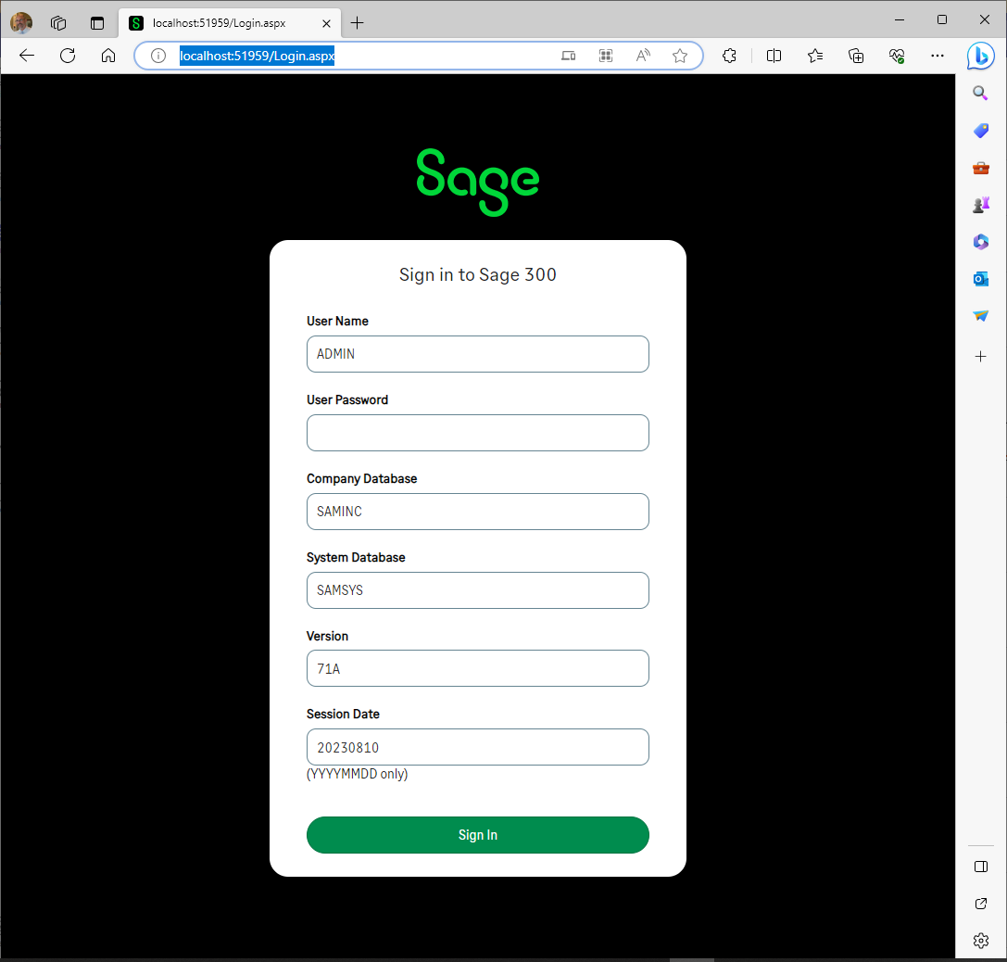
Samples
Sync global files
Accpac libraries from 70A to 71A
Nuget inconsistencies corrected
New Login.aspx page with branding changes
Web Screens

Slide 9
Web API

Slide 10
Web API
IC Item Location endpoint has been added (ICILOC)
Nuget inconsistencies corrected
Web Screens

Slide 11

Documentation and Tutorials

Slide 12
Documentation and Tutorials
Update CommonCore.chm
Updated upgrade instructions 2023.3 → 2024.0
Update Grid documentation for Grid Type
Updated Declarative Reports documentation
Updated Code Generation Wizard documentation
Web Screens

Slide 13

Miscellaneous

Slide 14
Miscellaneous
FYI
N/A
Web Screens

Slide 15
What’s Coming

Slide 16
What’s Coming
Roadmap
Subclassing POC is underway for both Web Screens and Web API
Proxy endpoint to enable display of any web screen
Elliptic Curve Encryption (ECC)
Proxy Tester to demonstrate invoking a screen with ECC
Web Screens
Tentative
Subclassing in Web Screens and Web API
AOM included in Web SDK
Hamburger implementation in generated finder code
Enhanced flow in Customization Wizard

Slide 17
GitHub Repository

Slide 18
GitHub Repository
Open Source
https://github.com/SageNADev/Sage300-SDK
2024.0 is available in the “master” branch
2024.1 is available in the “develop” branch
Archives
2023.3 available in “release-2023.3”
2023.1 available in “release-2023.1”
2023.0 available in “release-2023.0”
2022.1 available in “release-2022.2”
2022.1 available in “release-2022.1”
2022.0 available in “release-2022.0”
2021.2 available in “release-2021.2”
2021.0 available in “release-2021.0”
2020.2 available in “release-2020.2”
2020.1 available in “release-2020.1”
2020.0 available in “release-2020.0”
2019.2 available in “release-2019.2”
2019.1 available in “release-2019.1”
2019.0 available in “release-2019.0”
2018.2 available in “release-2018.2”
2018.1 available in “release-2018.1”
2018.0 available in “release-2018”
2017.2 available in “release-2017.2”
2017.1 available in “release-2017.1”
2017.0 available in “release-2017”
Web Screens

Slide 19
Partner Requests

Slide 20

Partner Requests
Bring these to the Sage 300 Product Manager
Add these to the Sage 300 Ideas Site
Sage 300 Ideas Forum
Your voice and feedback resounds the loudest!
Web Screens

Slide 21
Thank you!

